Slide 1
Heart Disease Prediction

Slide 2
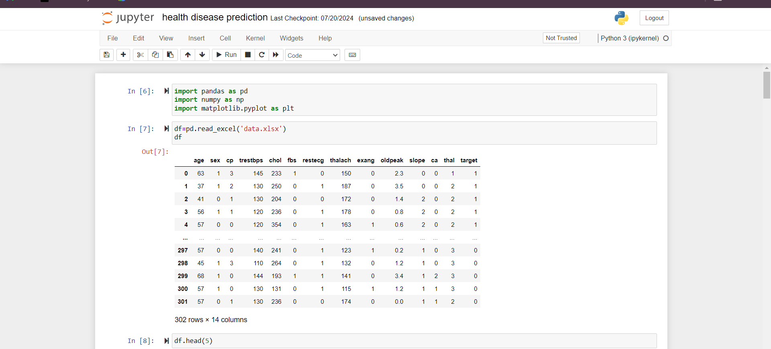
Import libraries

Slide 3
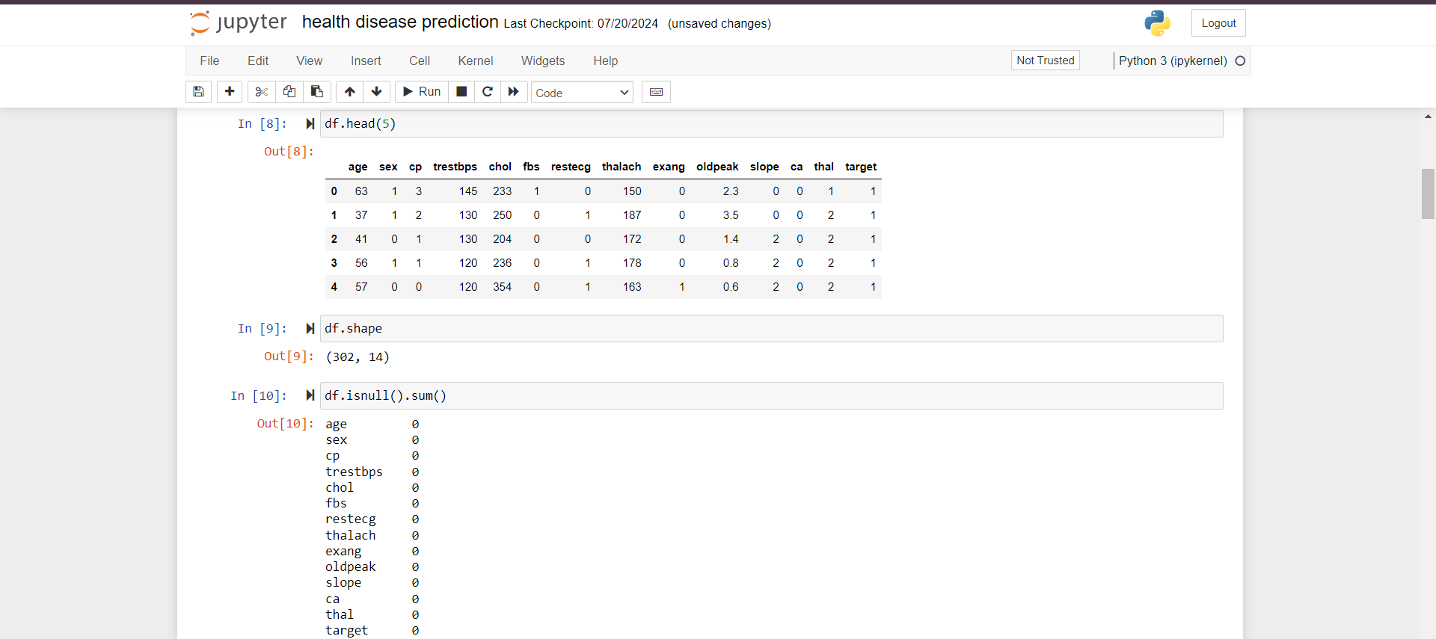
Check the null value

Slide 4
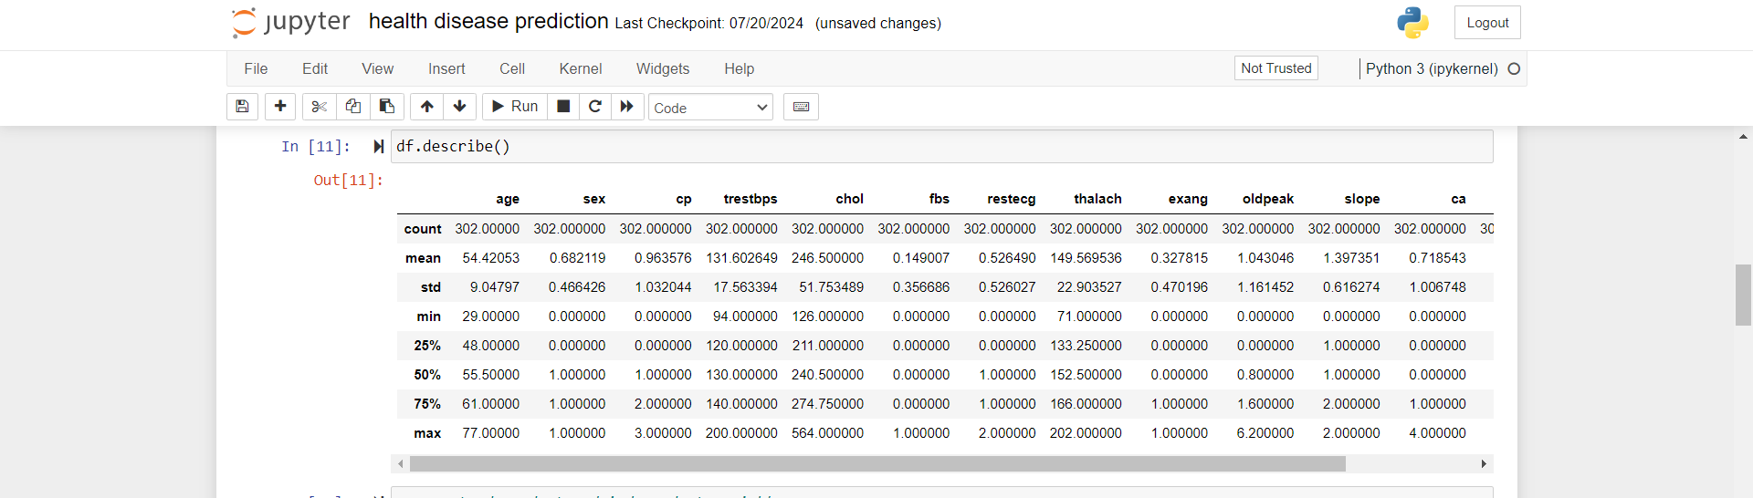
Describe() fun

Slide 5
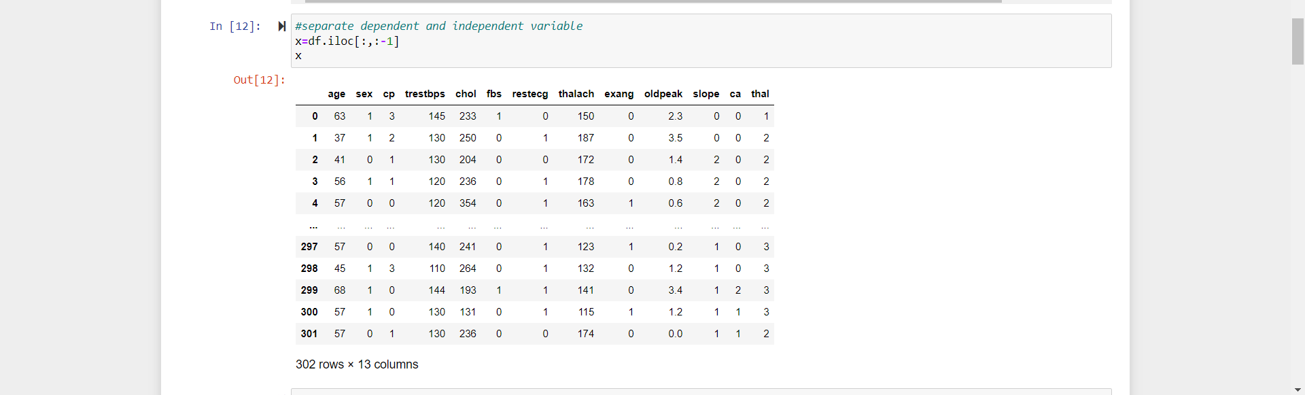
Independent variable

Slide 6
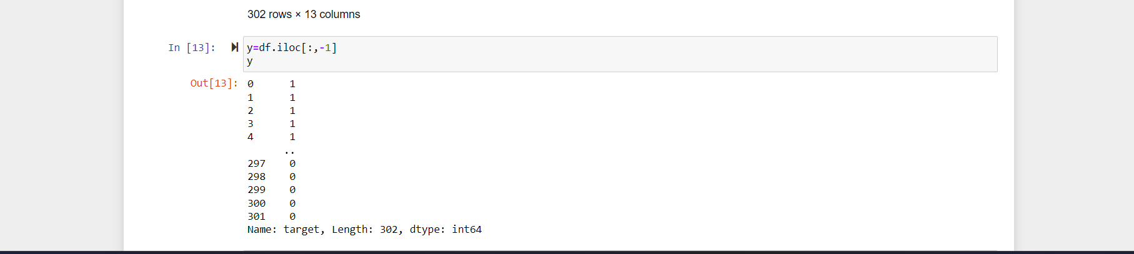
Dependent variable

Slide 7
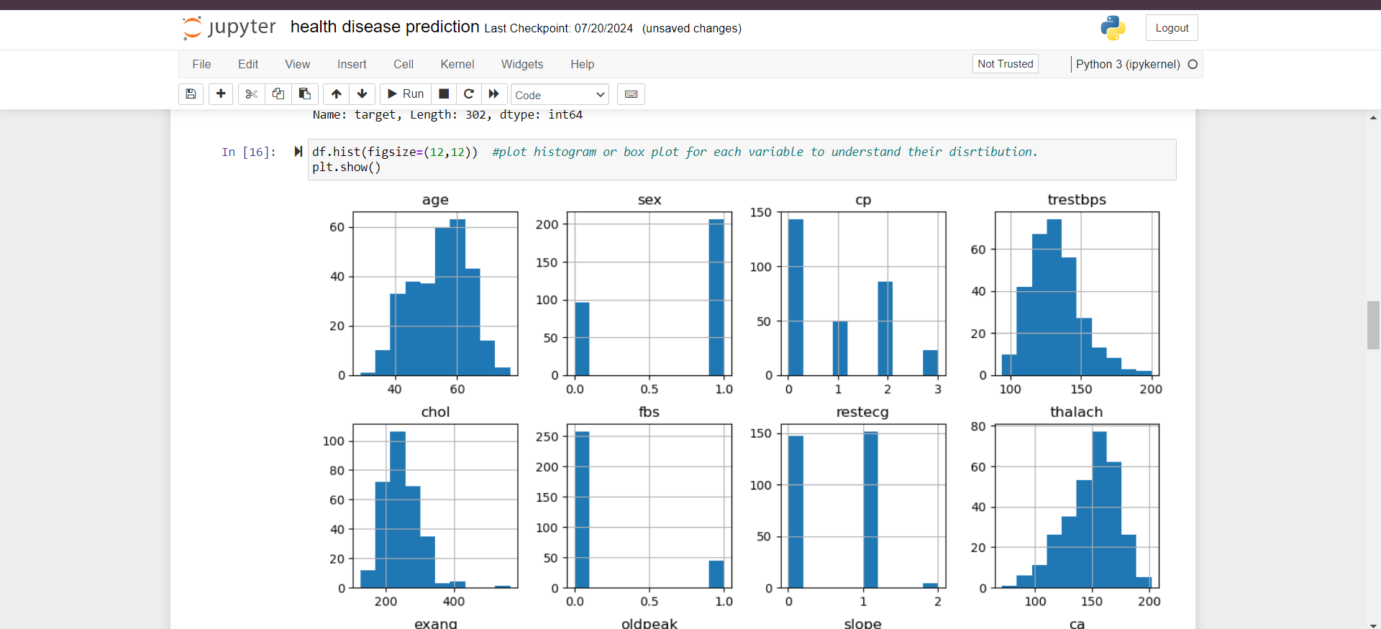
Histogram

Slide 8
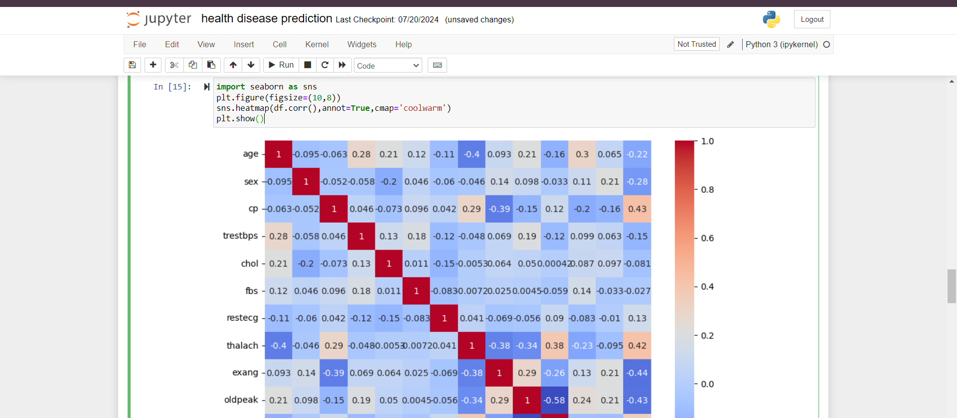
Heatmap function

Slide 9
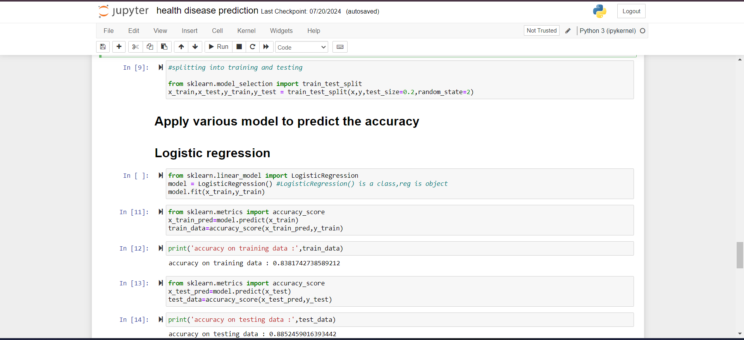
Logistic Regression model

Slide 10
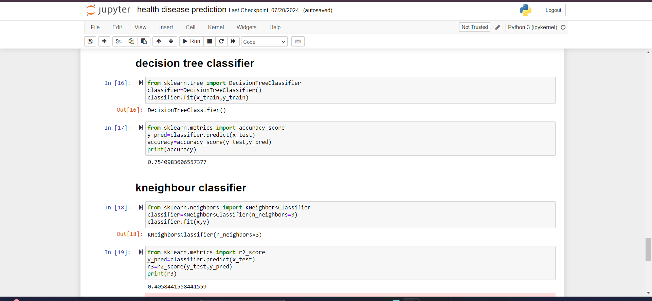
Decision Tree Classifier

Slide 11
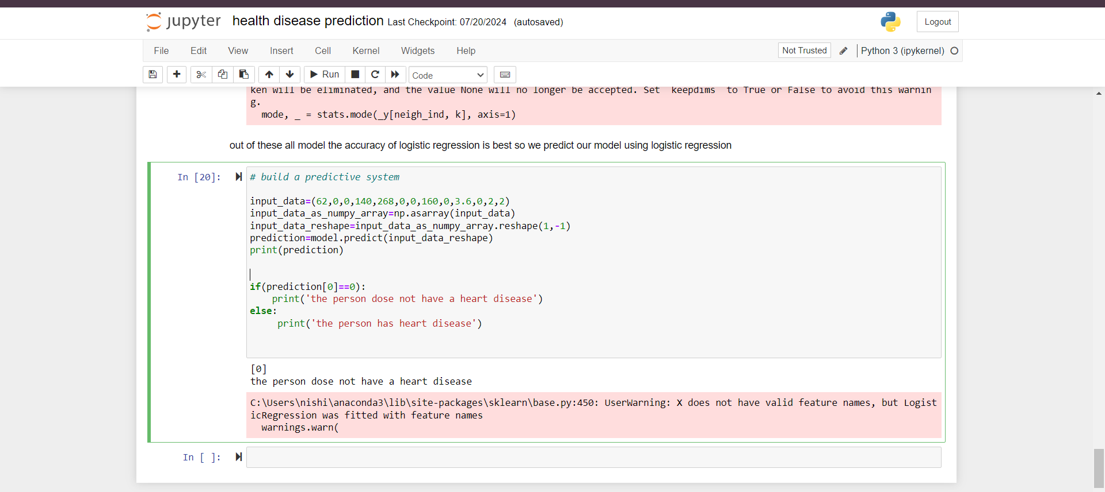
Predictive System

Slide 12
Decision Tree Classifier

Slide 13
thank you

